Slide 1












PT. SEDERU KARYA SELARAS
YOUR PARTNER SOLUTION

Slide 2








Slide 3





























Slide 4










Slide 5



















Slide 6







Slide 7








Slide 8




















Slide 9














Slide 10






”

Slide 11







Slide 12


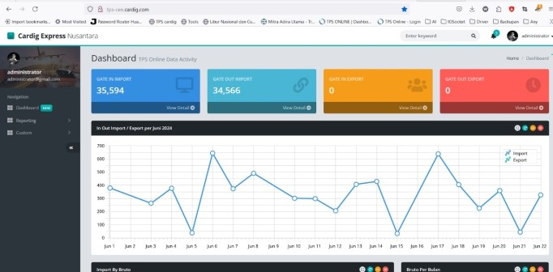
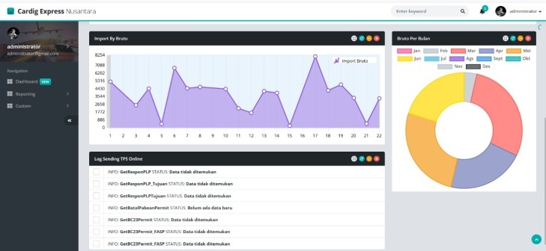
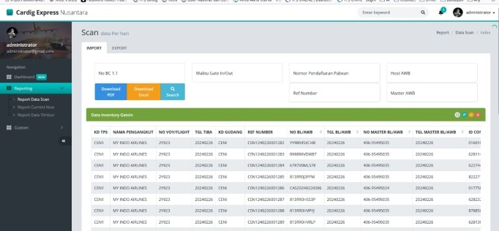
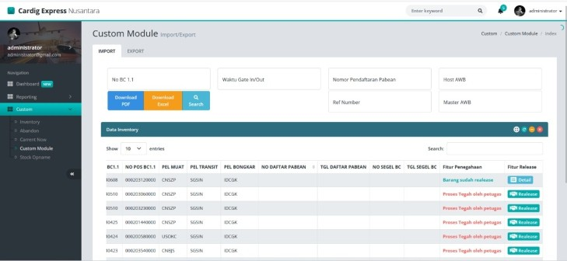
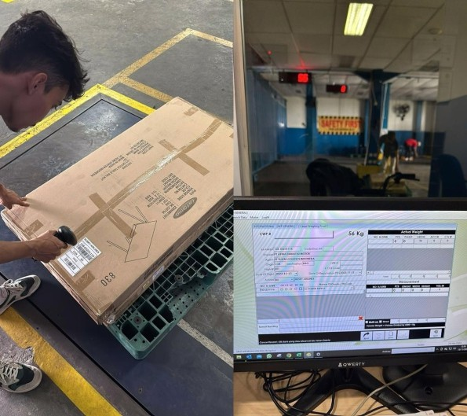
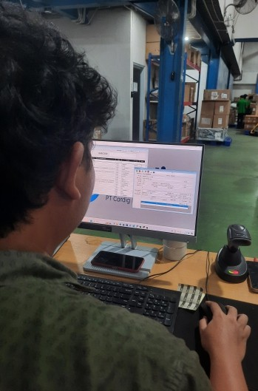
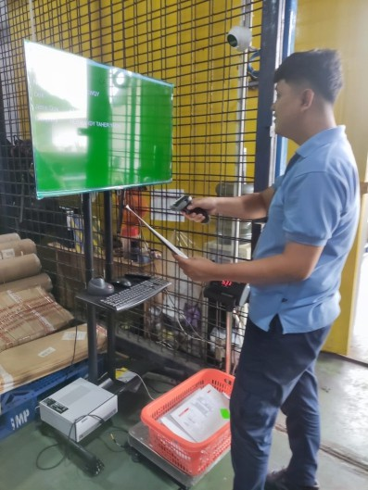
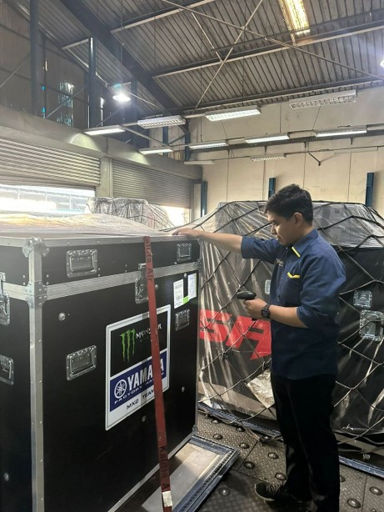
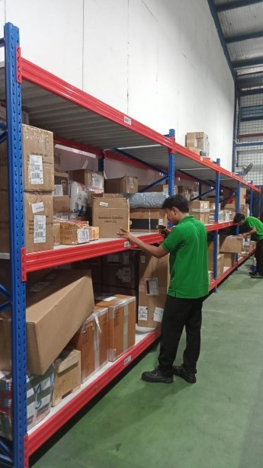


Slide 13





PT. SEDERU KARYA SELARAS
YOUR PARTNER SOLUTION

